Slide 1
ASSIGNMENT 1.
SOFTWARE ENGINEERING.

Slide 2
1. Windows 11 installation Process.
To install windows 11, first make sure that the system meets minimum requirements for windows 11 installation.
To effectively download use the provided link to download the windows 11 package.
https://www.microsoft.com/software-download/windows11
, you need a stable internet connection, back up your data and use Microsoft website to download.
The system requirements from the PC include; 1 GHz or more processor, RAM 4GB or more, ROM 64 GB or more, system firmware (UEFI, Secure boot capable), TPM Version 2.0, display >9” with HD resolution (720P) and a stable internet connection among others.
Download the windows installation media: i.e. using ISO File. Follow the steps highlighted.

Slide 3
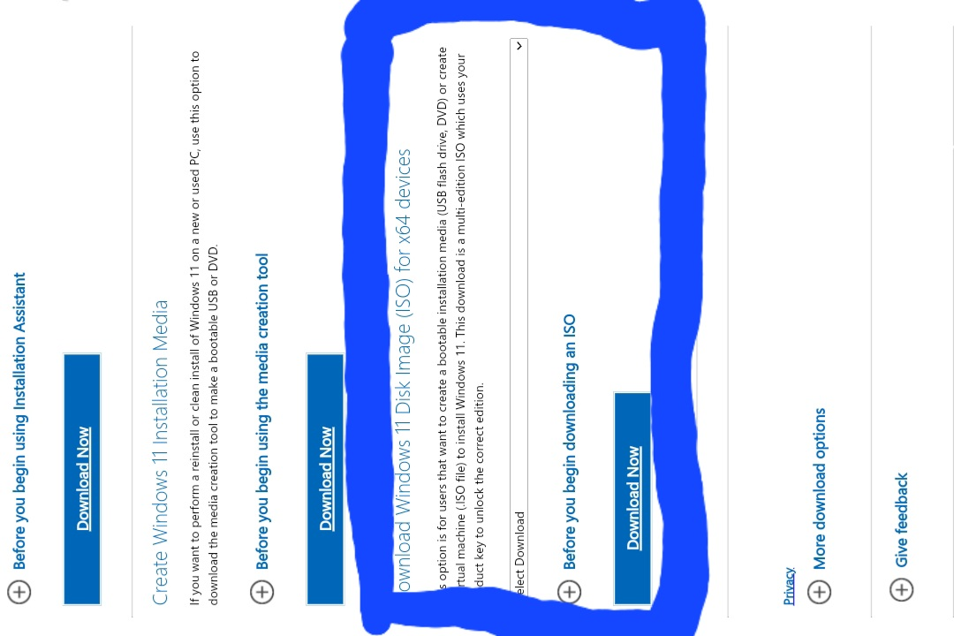
1. Select download windows 11 Disk Image (ISO) for x64 as shown in the image below.

Slide 4
Click on the 64 bit download button to download the ISO file.
Create a bootable media.
Upon installation, if you created a bootable media i.e. bootable USB drive, insert it into your PC and restart the computer.
Enter the BIOS/UEFI settings by pressing F2, F12, Delete or Esc buttons during the startup.
Set the USB drive as the primary boot device.
Save changes and restart your PC.
Thereafter follow on the screen instructions to install Windows 11.
Once installed, you may need to install some drivers and updates, so ensure your internet connection is stable.

Slide 5
2. DOWNLOADING VISUAL STUDIO CODE.
To install VS code, Text Editor and IDE by Microsoft, follow the steps;
Download Visual Studio Code.
Visit the visual studio code website by the help of the below link to download, https://code.visualstudio.com/Download
Download the installer for the download for windows button if you are using windows and macOS or Linux, based on your system.
2. Install Visual Studio Code.
Once the download is complete, open the downloaded file.
Accept the license agreement and click next.
Choose installation location or keep the default path then click next.

Slide 6
Select any additional tasks you want such as creating desktop icon then click NEXT.
Click install to begin the installation process.
Once the installation is complete, check the box to launch Visual Studio Code, then click FINISH.
3. Launch and set up Visual Studio Code.
Open visual studio code if you didn’t choose launch studio code after installation.
You can customize your setups by installing extensions by clicking ‘ctrl + shift + x’
Search for and install extensions relevant to your programming languages and workflow; i.e. python.
Adjust settings to suit your preferences.

Slide 7
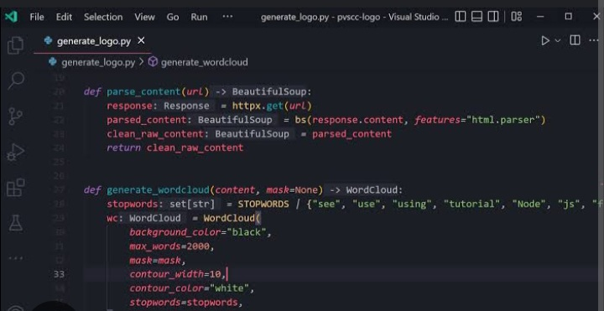

Slide 8
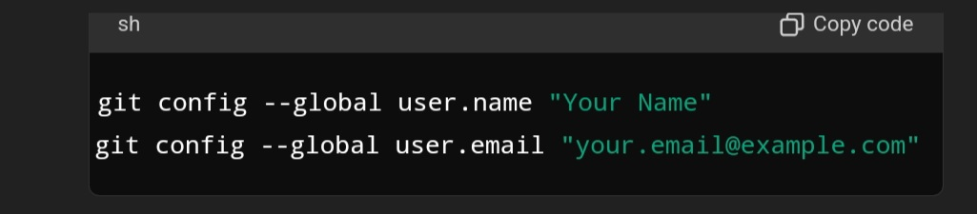
3. SETTING UP A VERSION CONTROL SYSTEM.
Download Git for your windows from the link below. https://github.com
Run the installer and follow the setup instructions.
Once installed, you can use Git Bash, Git UI, or integrate with other tools like visual studio code.
STEP 2 (Configure Git).
Open a terminal or Git Bash and set your global Git configuration.
You can verify your configuration within the code: git config --list

Slide 9
3. Create a Git Hub account.
Go to your git hub and click “sign up” and follow the instructions to create an account.
4. Create a New Repository on GitHub.
Once logged in, click on the “+” icon at the top right corner and select “New Repository”.
Fill the name and the description of your repository and choose whether to make it private or public based on the commits you want to put in then create repository.
5. initialize a Git Repository Locally.
Navigate your project directory in the terminal and then initialize new repositories using code; git init
Add project files on the repository by code: git add
Make your first commit: git commit –m “Initial commit”

Slide 10
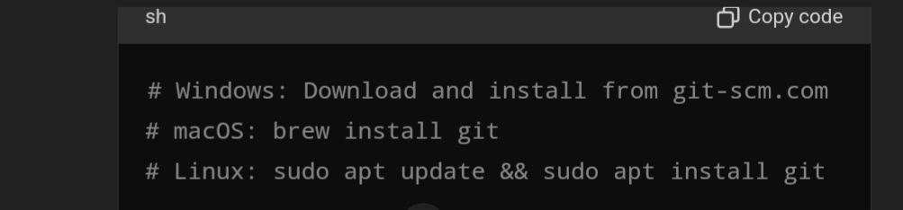
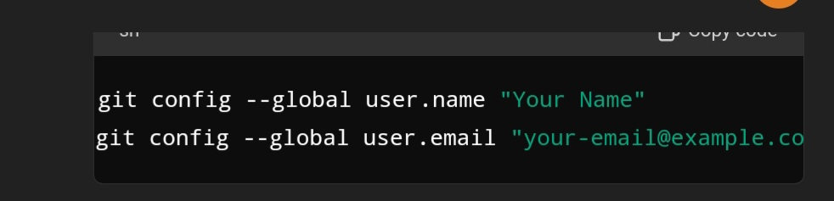
6. Push your project to GitHub.
Link your normal repository to your GitHub repository: git remote add origin https://github.com/your-username/your-repo-name.git
Push your local commits to GitHub by the command: git push –u origin master
This will push your initial commit to master branch on GitHub

Slide 11
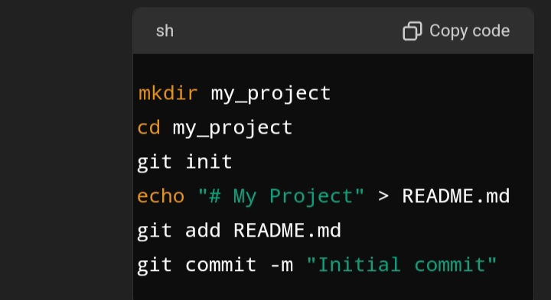
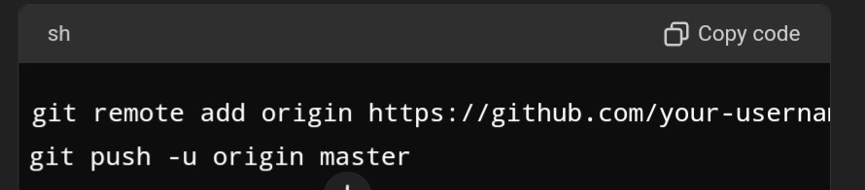

Slide 12
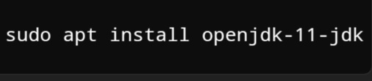
4. Python Installation.
To set up environment necessary for programming languages, interoreters, and runtimes, follow these steps:
Install Python.
Download the python installer from the site: http://wwww.python.org
open the downloaded ‘.pkg’ file and follow the instructions to install.
2. Install compliers, interpreters and runtimes.
Depending on the languages you need, you might need to install additional tools; i.e.
. Java, (download java from oracle or install OpenJDK:
. Node.js, (visit Node.js official website and download the LTS version.

Slide 13
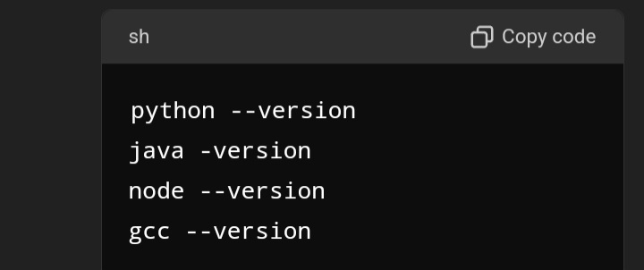
Install C/C++, on the official website for the OS you are using.
3. Verify installations.
After installing, verify installations by checking the version numbers:
4. Additional tools.
Ensure you have tools like ‘pip’ for python management and ‘npm’ Node.js
*Following the steps will enable you have all necessary programming languages and their tools installed.

